Slide 1

Player Efficiency Rating…
But is it Really Efficient?
By: Chris, Davis, Drew, and Ward

Slide 2
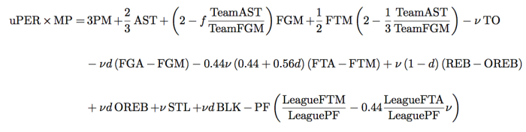
PER
Player Efficiency Rating is a per-minute rating developed by John Hollinger
“The PER sums up all a player's positive accomplishments, subtracts the negative accomplishments, and returns a per-minute rating of a player's performance.”
However, there have been many conclusions exposing the PER statistic and its flaws.

Slide 3
Problems with PER
Although a statistic with tremendous potential, PER is quite disappointing in the NBA right now.
First of all, PER is really only an offensive rating. The stat includes blocks and steals, however it does not actually measure a player’s defensive efficiency.
It allows for positional biases. The stat favors centers who don’t handle the ball much and don’t create their own shots.
The PER equation does not take into account assisted versus unassisted field goals. Therefore players who receive easy layups from teammates will produce a higher PER.

Slide 4
What we chose to attack
Although there are many routes we could have gone to produce an improved PER, we chose to pursue the positional bias with the stat. We altered the equation and broke league averages into three categories (Guards, Forwards, Centers).
Along with the four stats next to the arrow, we had to use positional averages for
v or VOP - (value of possession)
f or Factor
d or DRB% - (defensive rebound percentage)

Slide 5
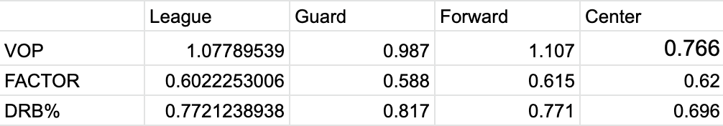
How we went about our data
Filtered players by position and obtained their 2018-2019 stats from stats.NBA.com
Only looked at players who played at least 20 games and 10 mins per game
Next, we copied each players PER from the 2018-19 season from Basketball-reference.com
Then, we found each players team’s AST and team’s FGM
Through excel, we calculated each positions VOP, FACTOR, and DRB%
Finally we plugged each cell into the PER equation

Slide 6
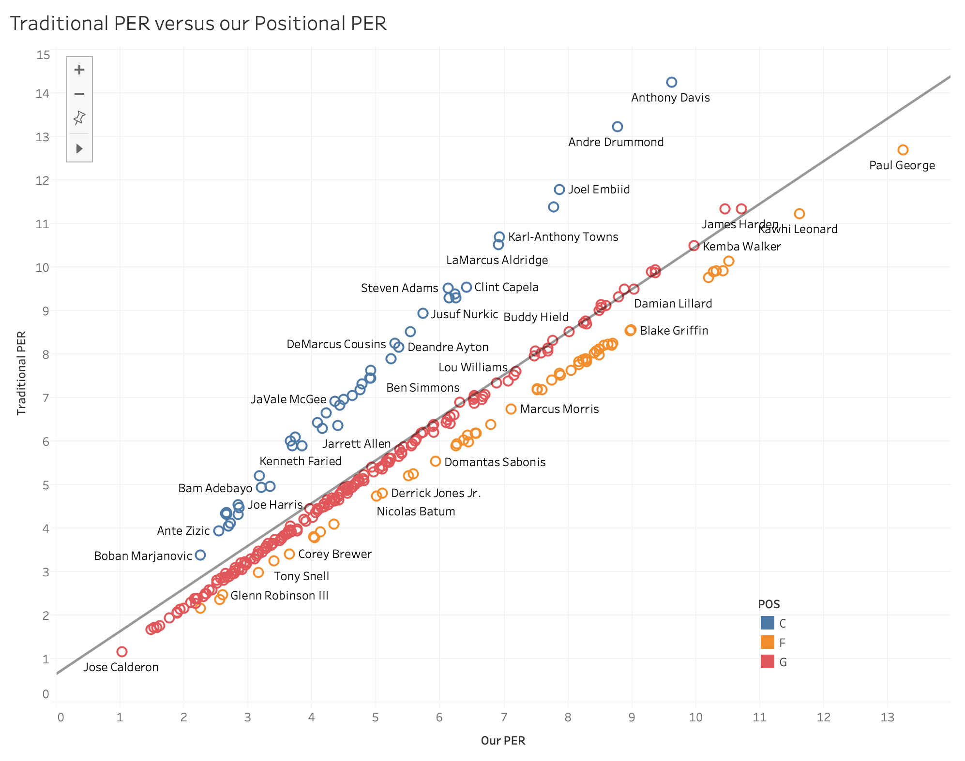
Our findings
As you can tell, centers seem to be over-valued in the traditional PER.
In our PER, forwards take the lead role.

Slide 7
Our findings cont.
Directly comparing the top 30 players from our PER to the traditional, here is the breakdown:
Our PER | Traditional PER
Guards - 13 | Guards - 12
Forwards - 15 | Forwards - 7
Centers - 2 | Centers - 11

Slide 8
Comparison with ESPN’s real +/-
We used ESPN’s real plus-minus as a reference for comparison for both of the PER stats.
Real plus-minus is arguably one of the better ways to compare players.
ESPN’s real plus-minus contains 9 centers in their top 30, which is in between the two PERs.
While our PER may slightly undervalue centers, an adjustment with pace may correct for this.

Slide 9
Conclusion
The PER stat is bad. However, is has the potential to be better.
Altering the equation to accommodate positional averages is just one step in the right direction.
Our positional PER tried to correct for overvaluing centers. It seems to value forwards highly now, which we feel makes more sense than centers.
Given more time, an adjustment to our PER involving pace would give us better insight towards a better PER stat.

Slide 10
References
Bullsville. “The Bulls, PER, and the Idiots Who Live by It.” ChicagoNow Is Full of Win, 15 Sept. 2013, www.chicagonow.com/bullsville/2013/09/the-bulls-per-and-the-idiots-who-live-by-it/.
Scaletta, Kelly. “The NBA's 10 Most Meaningless Stats and Arguments.” Bleacher Report, Bleacher Report, 3 Oct. 2017, bleacherreport.com/articles/815181-nba-power-rankings-the-10-most-meaningless-stats-and-arguments-in-basketball%2523slide5#slide4.
Shami, Zein. “The Definitive PER Criticism.” The Z Score, 24 Sept. 2019, thezscore.com/2016/02/17/the-definitive-per-criticism/.

